Slide 1
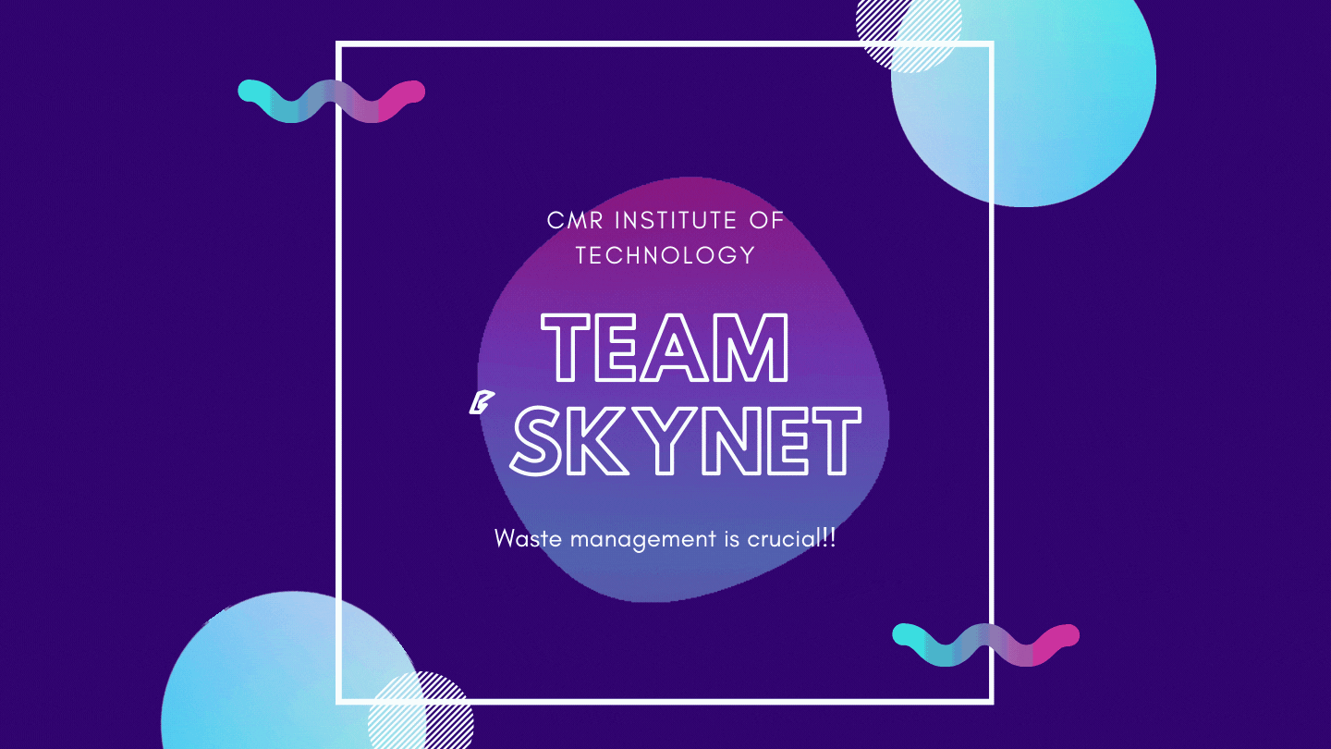

Slide 2
HackOverflow
TEAM MEMBERS
GAURAV KHATER (1CR20CS065)
CHANDRA PRATAP SINGH CHAUHAN (1CR20CS043)
KUMAR SATWIK (1CR20IS086)
HARSHENDU MAHTO (1CR20CS077)

Slide 3
https://environment-friend.netlify.app/#home
Website

Slide 4
PROBLEM STATEMENT
REDUCE,REUSE AND RECYCLE
India has a massive problem in relation to the wastage and disposal of goods. We desperately need to adopt more measures in our day to day life to help curb the environmental disaster that this could bring about. Your task is to design an app/website that helps tackle this problem via informing and helping the consumer with regard to the know-how and execution of this broader idea. The system should keep a track on the statistics of used,unused and wasted goods to help the user understand his/her day to day need and cut down on over production and bring about a conserved change without harming any interest of the consumers.

Slide 5

FEATURES
Environment Friend
Chatbot Integration.
Multi-page Website which includes sections like home,about,effects,stats,volunteer.
Responsive Website.
Form which stores name,email,phone and a picture.
Simple and Professional Web Design
Clean, user friendly navigation.

Slide 6

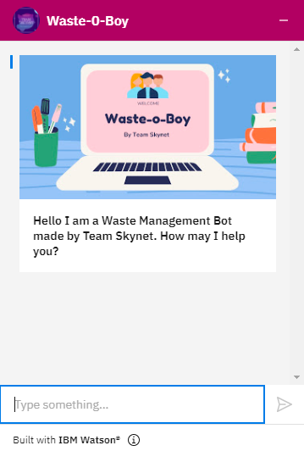
Waste-O-Boy
(Chatbot Integration)
Our team noticed a popular trend among MNC’s of integrating a chatbot in their websites. We did something on similar lines and integrated a fully functional chatbot that will not only guide the user through the website but also provide a summary of the information present on the website.

Slide 7
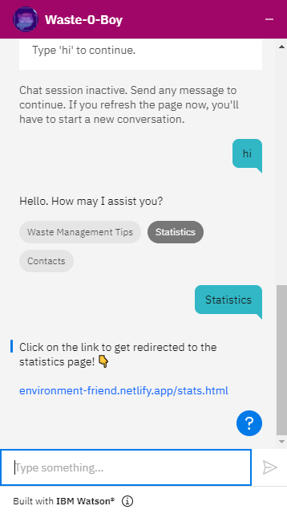
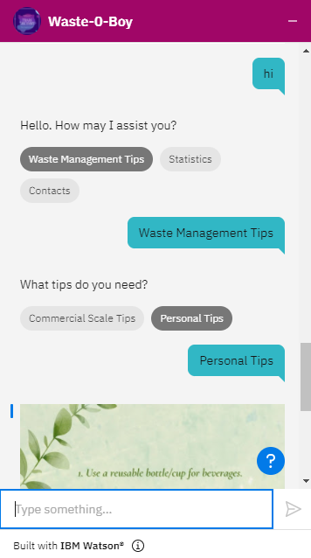
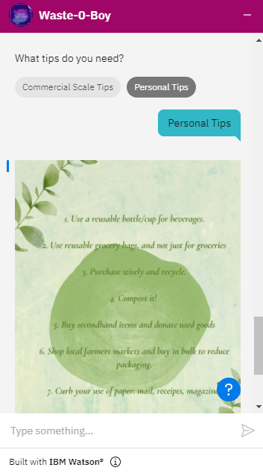

Slide 8
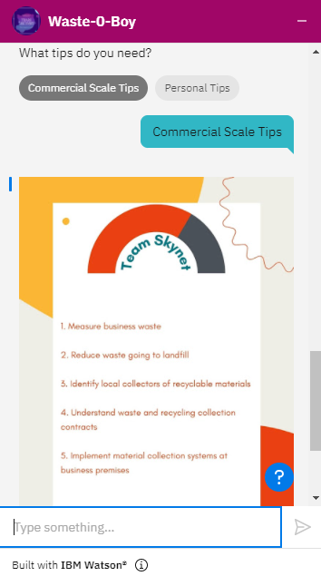
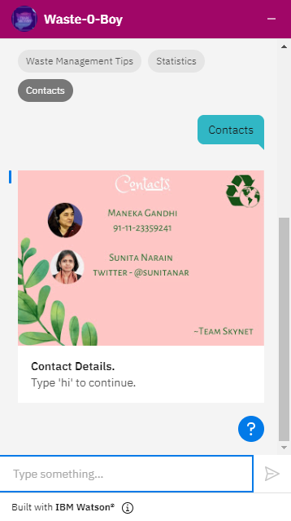

Slide 9
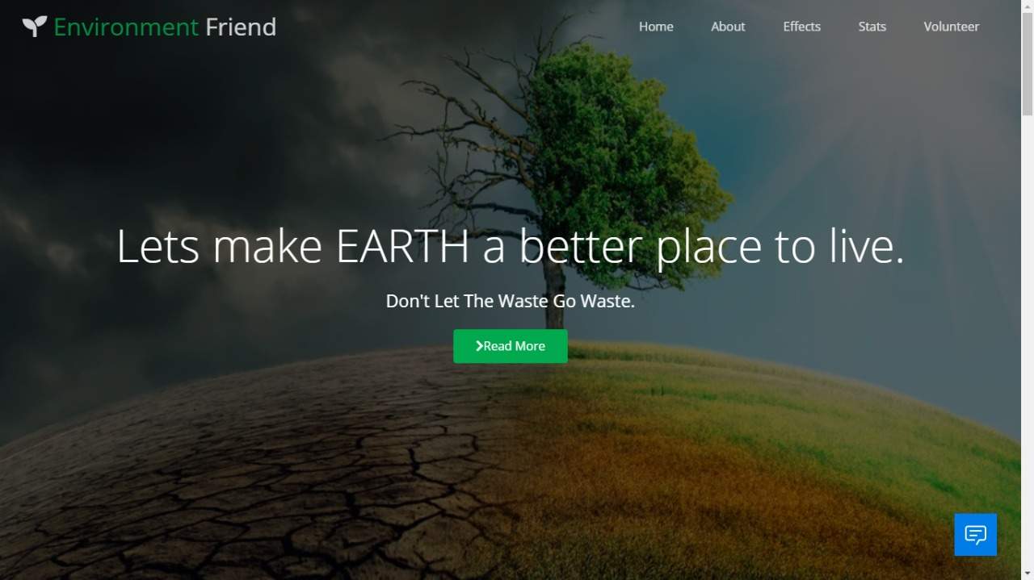
Page Layout

Slide 10
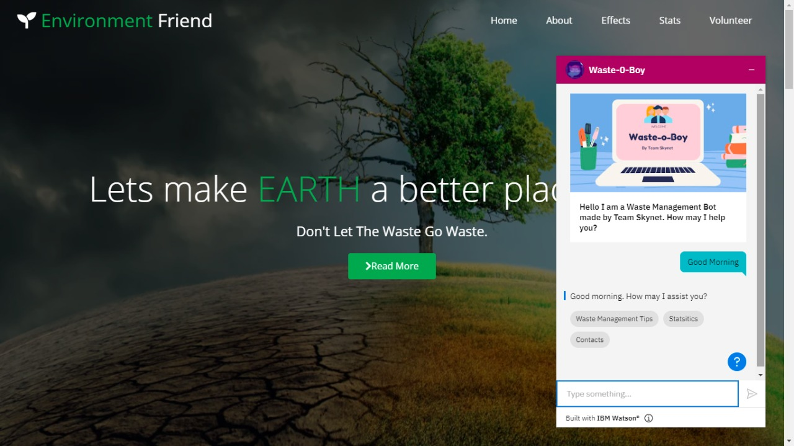

Slide 11
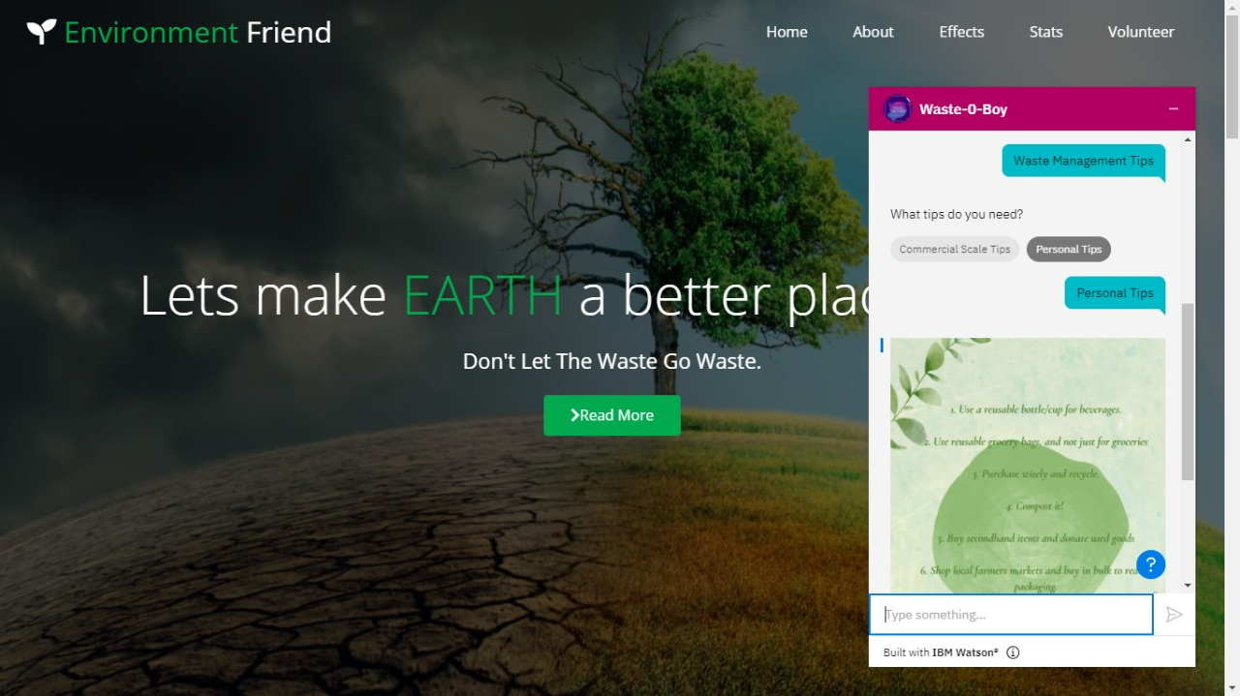

Slide 12
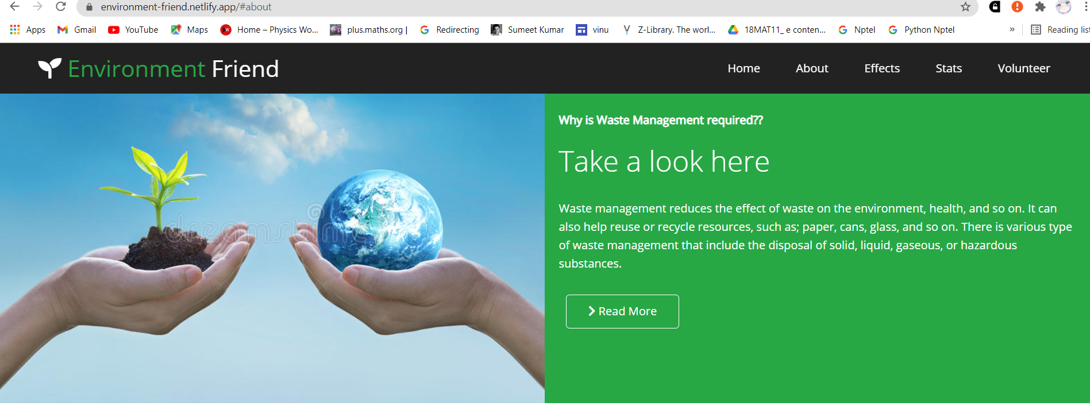

Slide 13
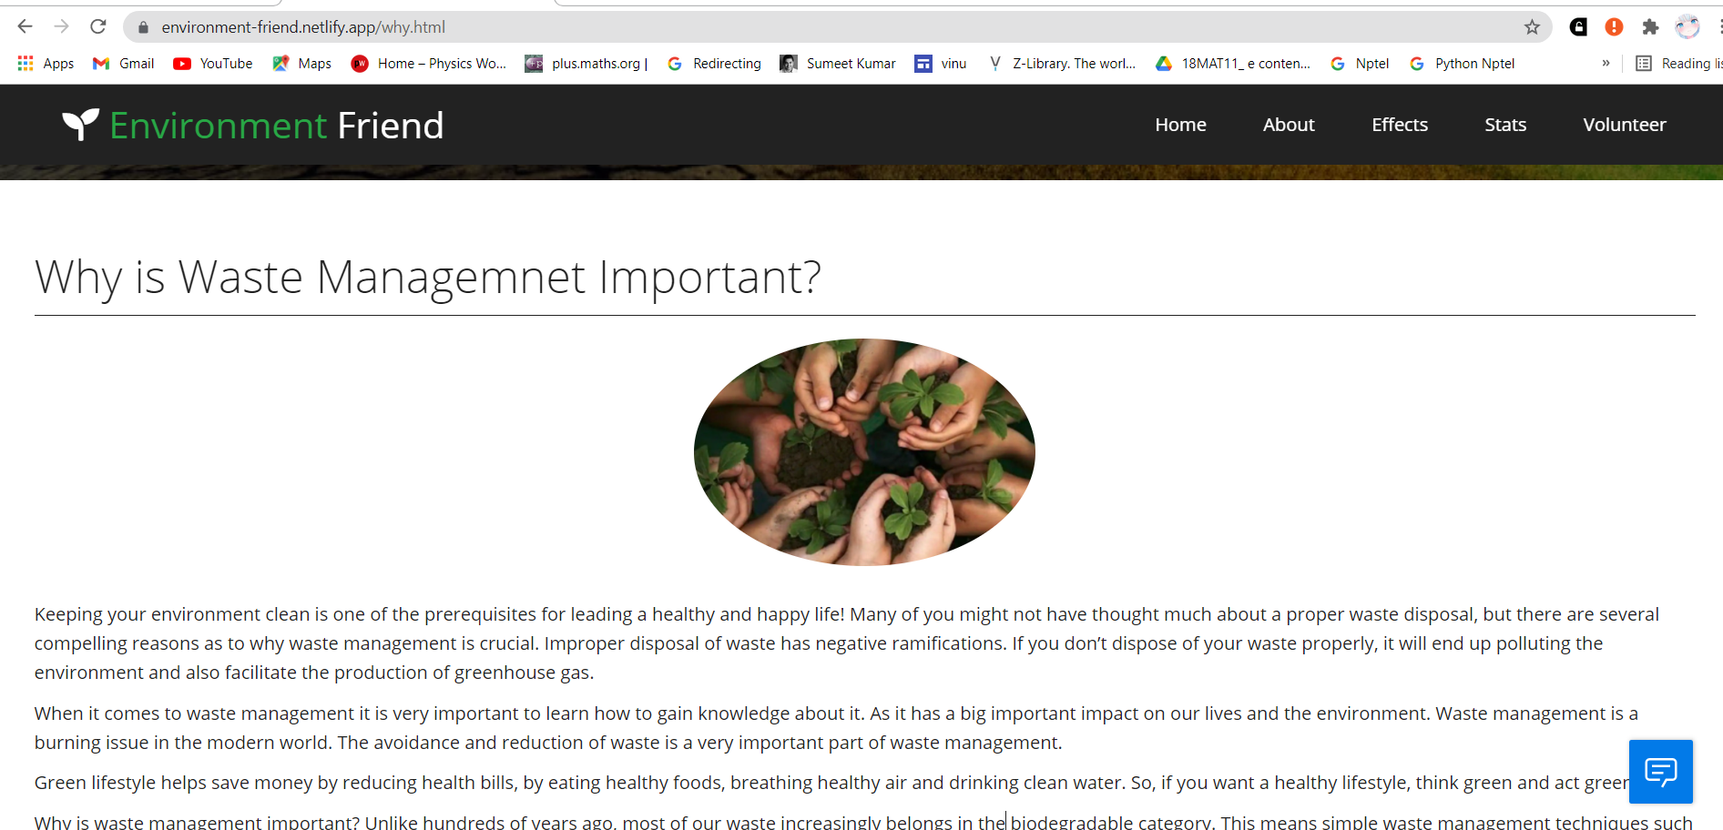

Slide 14
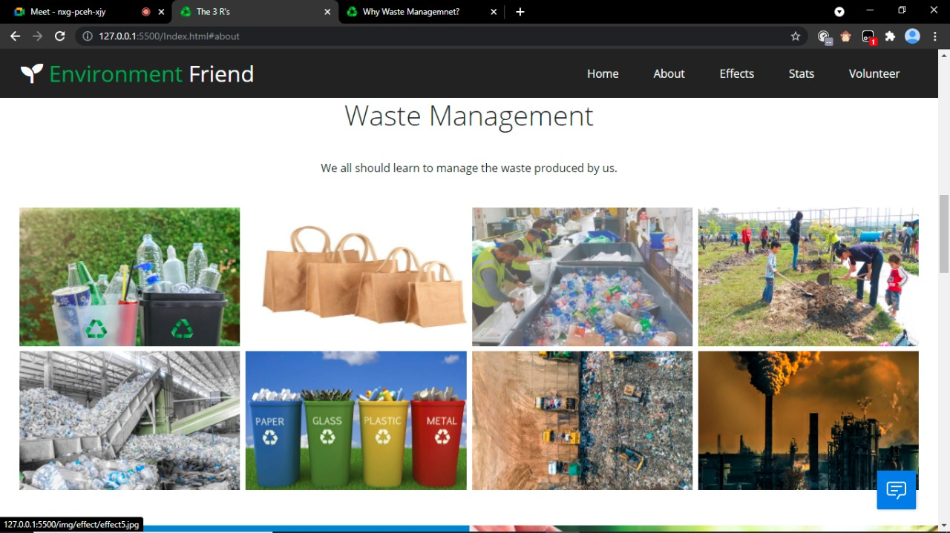

Slide 15
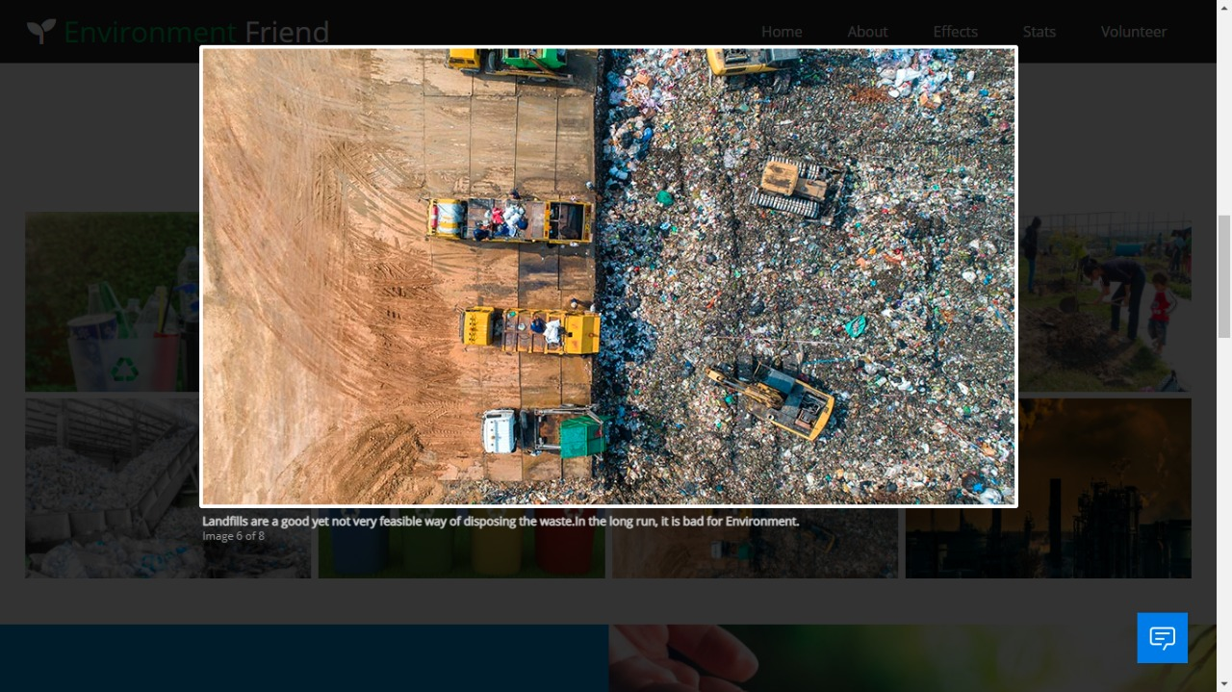

Slide 16
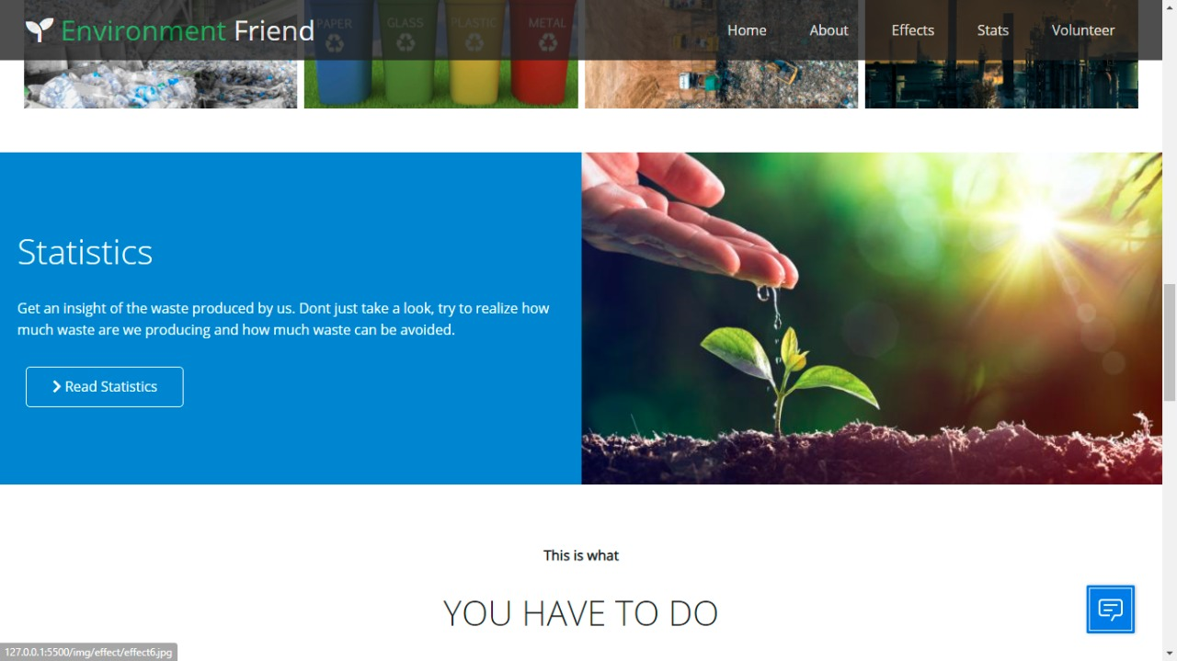

Slide 17
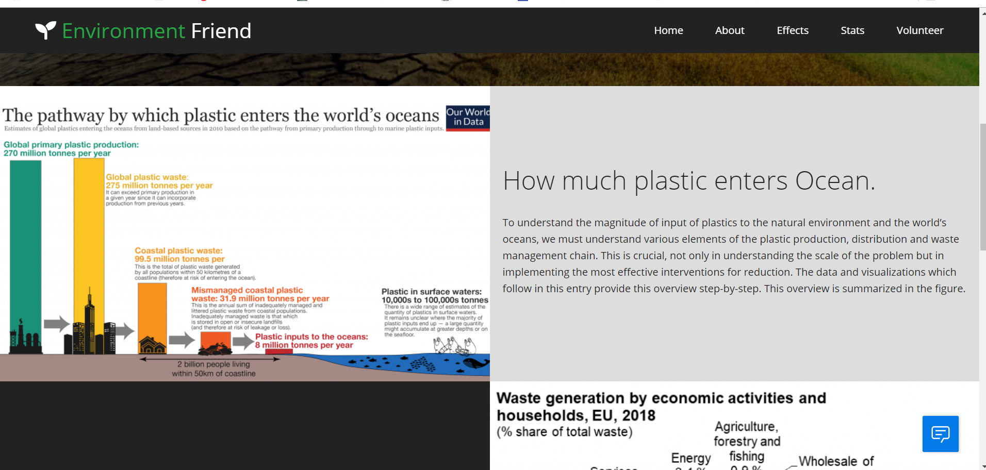

Slide 18
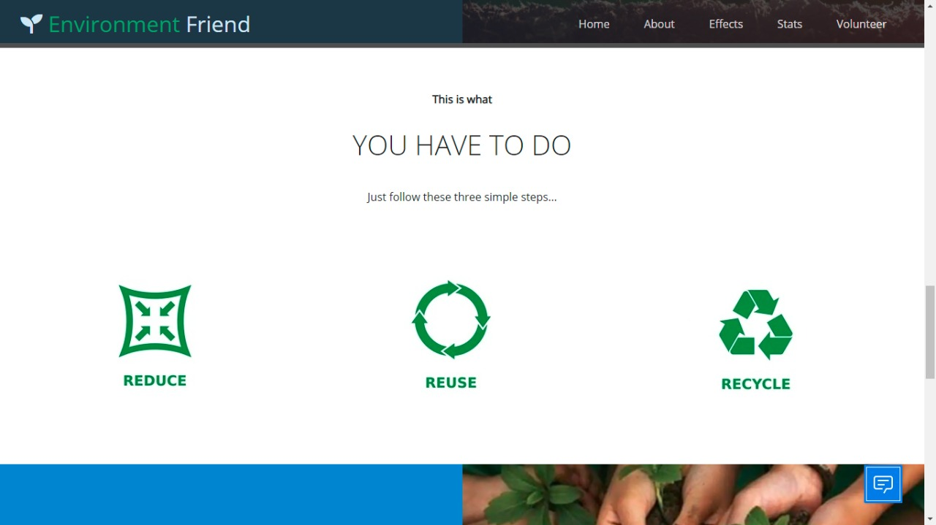

Slide 19
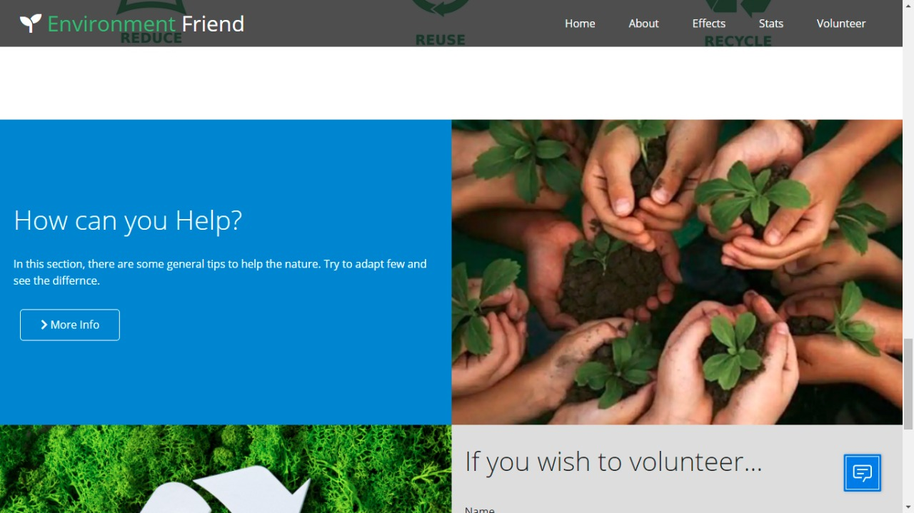

Slide 20
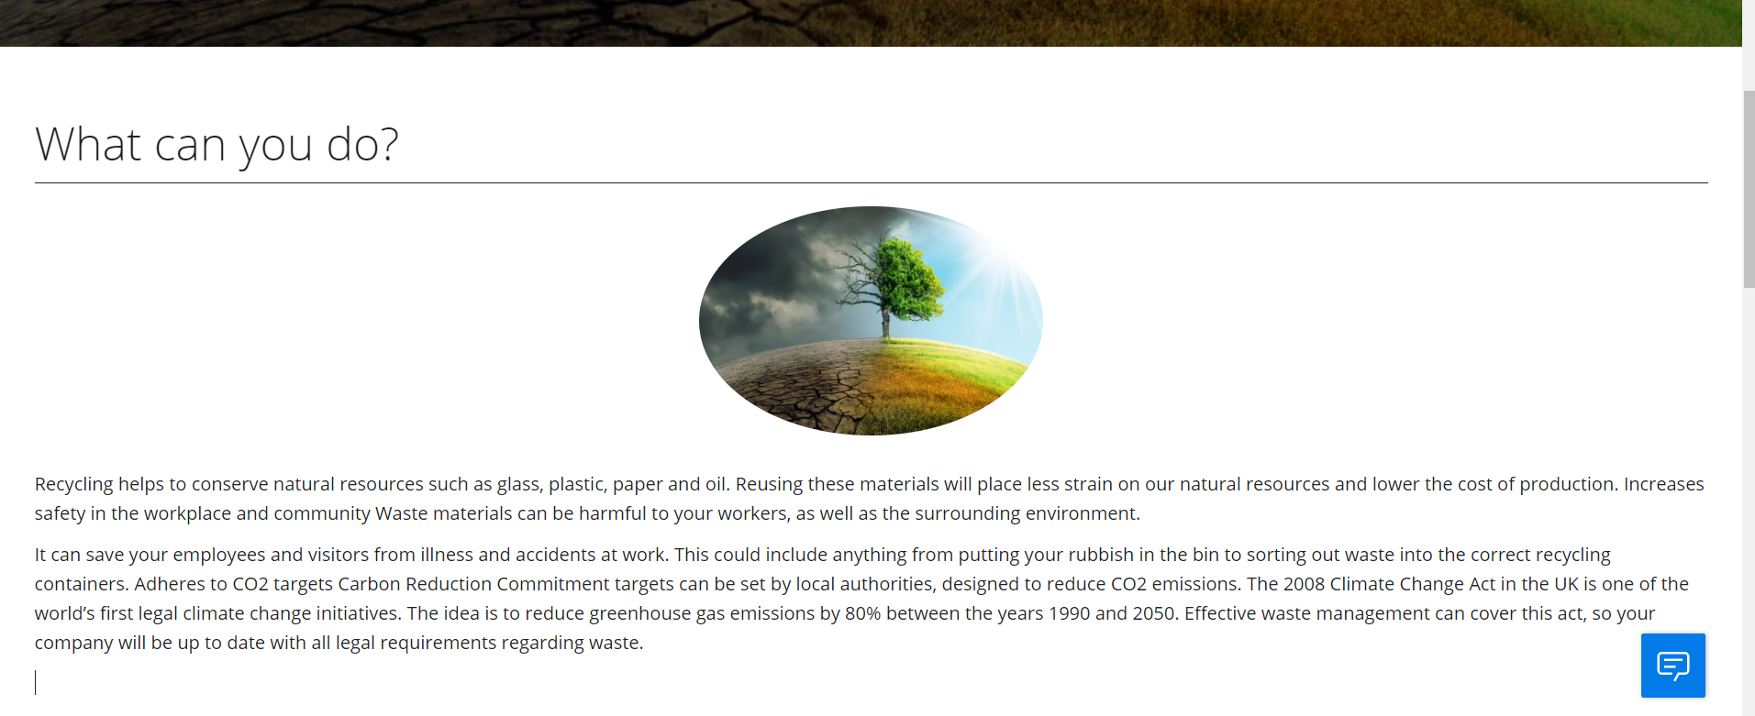

Slide 21
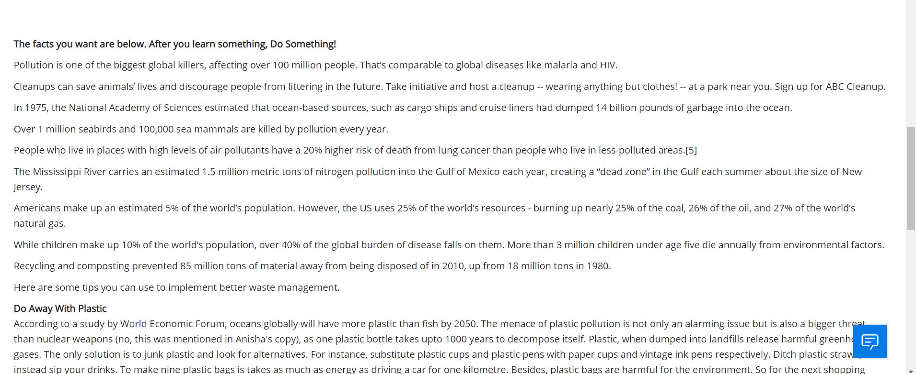

Slide 22
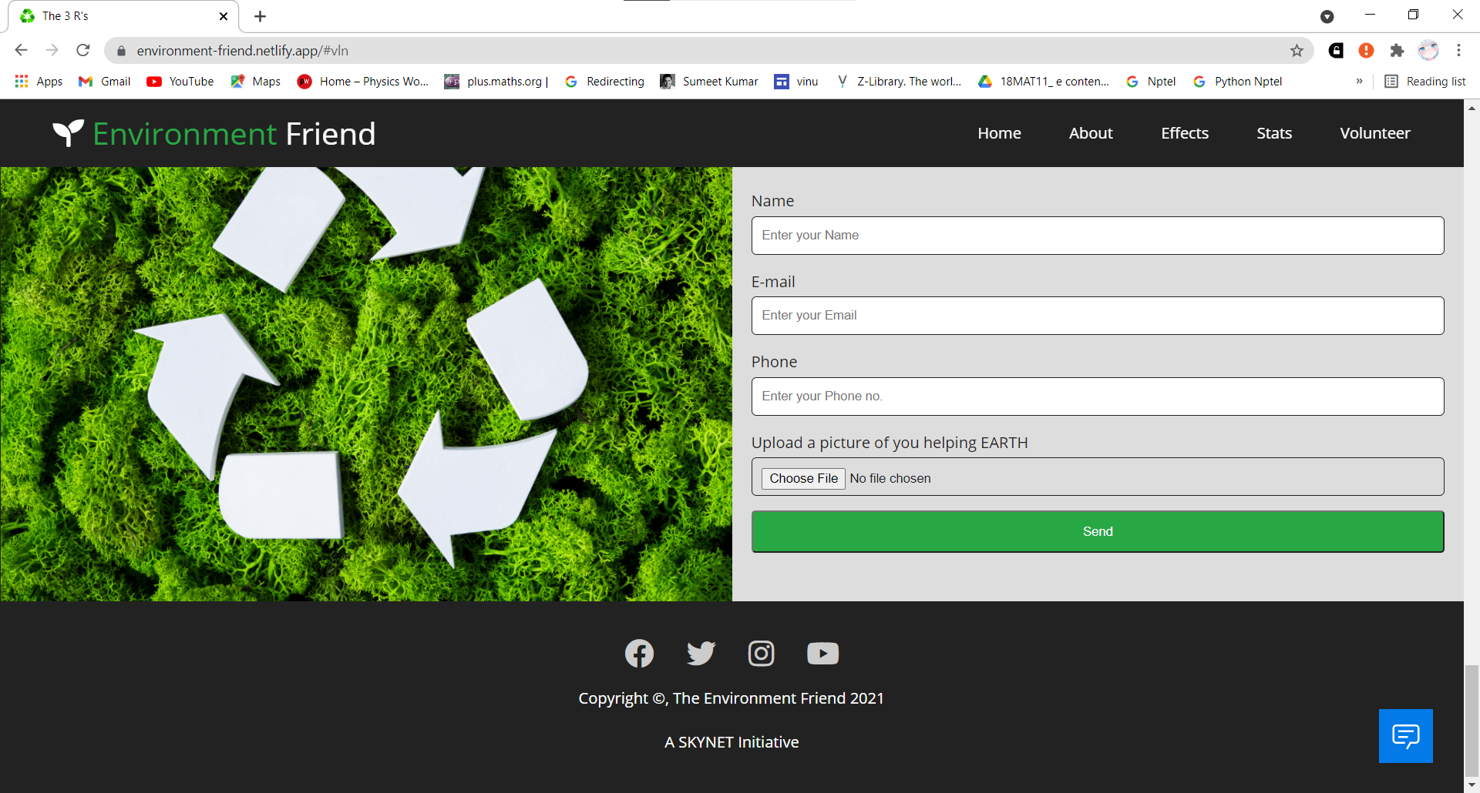

Slide 23
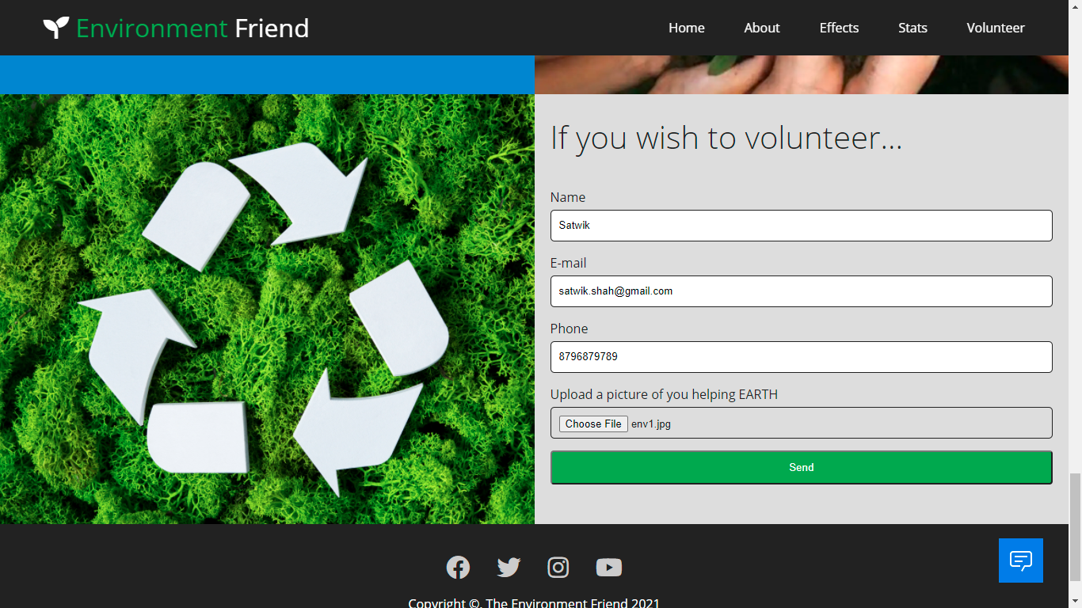

Slide 24
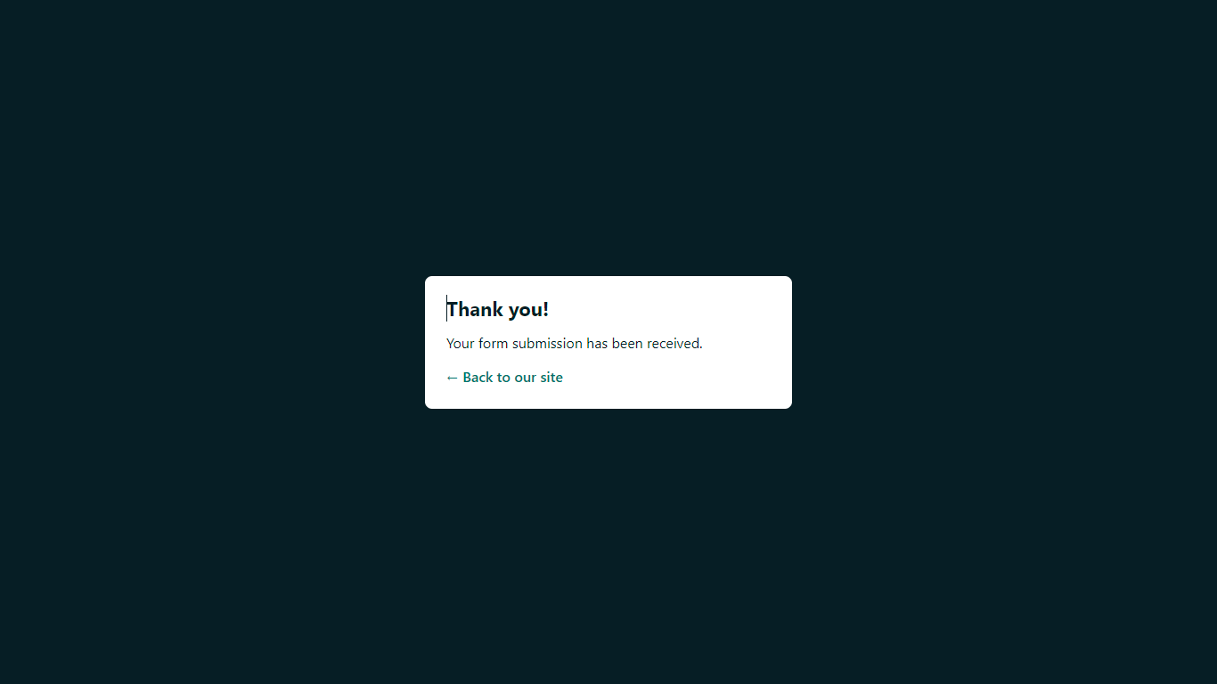

Slide 25
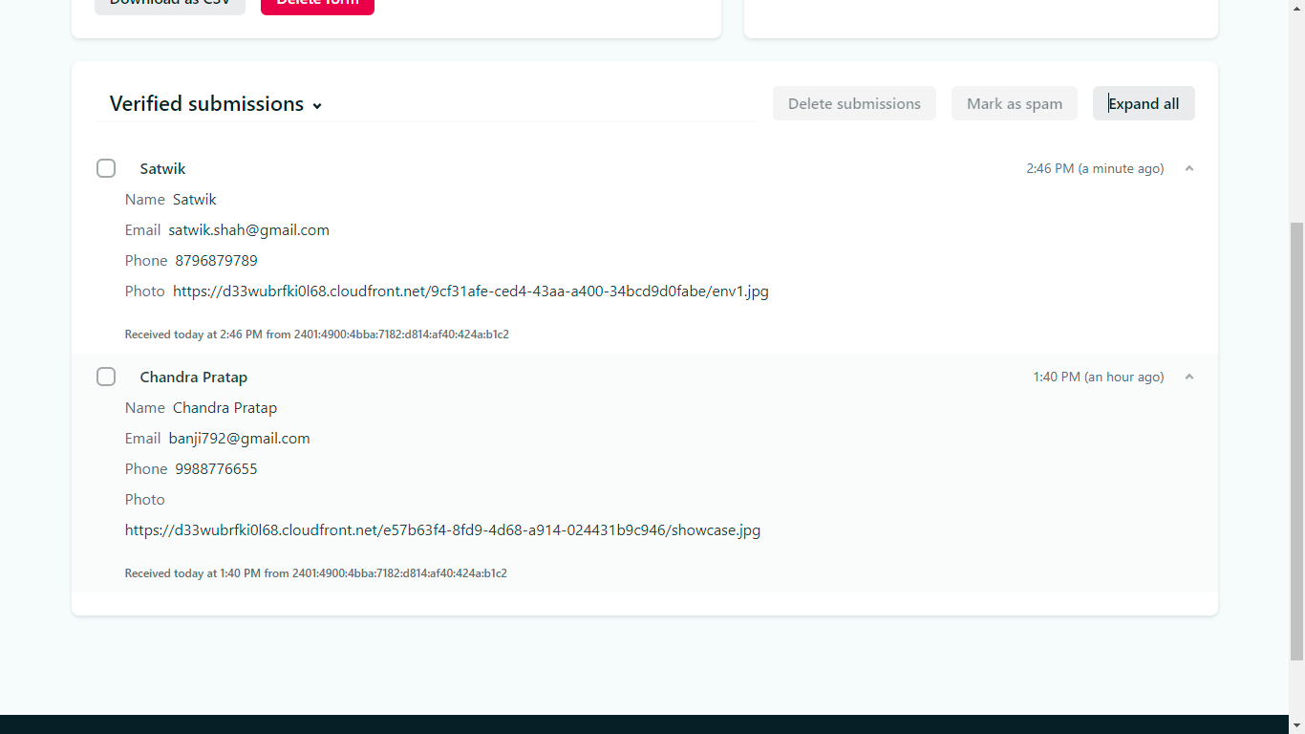

Slide 26
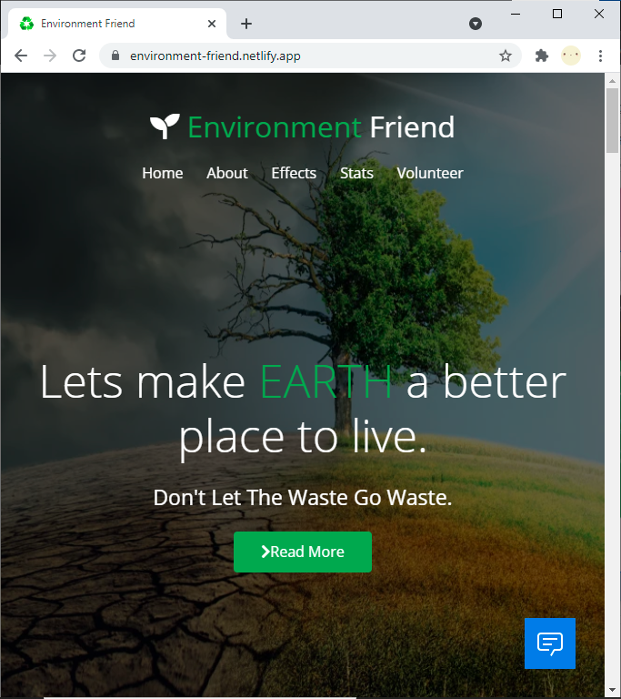
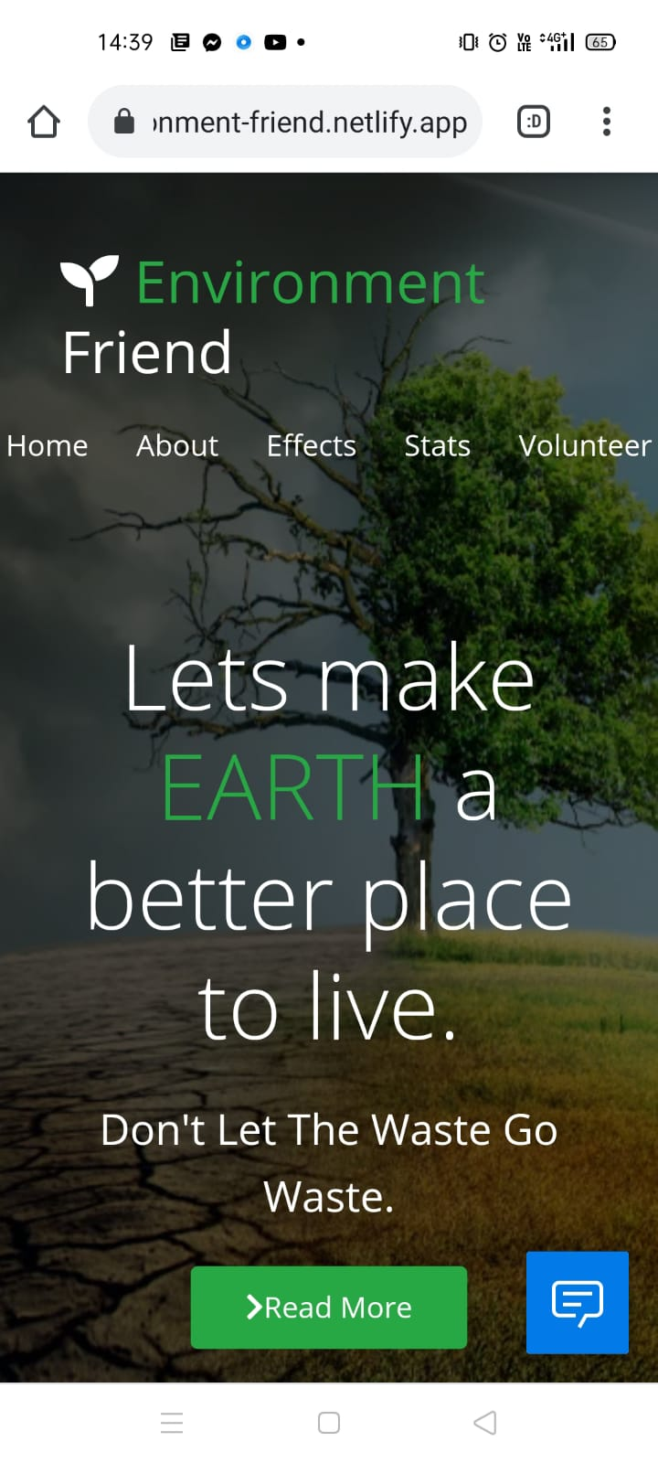
Responsive Website
Website on Phone

